Slide 1
Fake or Real Job Posts Identification
By: Wei Feng
Jovan Sie
Tony Tan
Lab Group: SC9
Team: 4
SC1015 - Data Science & Artificial Intelligence

Slide 2
Outline
Natural Language Processing
01
Dataset
05
Real / Fake Job Posts
Text Data
02
Problem Definition
06
Machine Learning Classifier Models
SGDClassifier, Random Forest, K-Neighbours
03
Data Preparation
Preparing and Cleaning
07
Insights and Recommendations
04
Exploratory Data Analysis
Numerical and Categorical

Slide 3
Dataset
Real / Fake Job Posting Prediction
From Kaggle
Dataset: https://www.kaggle.com/datasets/shivamb/real-or-fake-fake-
Jobposting-prediction
Contains 18k Job Posts, 800 Fraudulent ones

Slide 4
Problem Definition
What variables can help determine whether a post is fraudulent or not?
Which classification model can help predict a fraudulent post?
Real-Life Problem
A website that can filter out fraudulent posts can promote more visitors to browse the site, as well as more companies to post their job post

Slide 5
Data Cleaning & Preparation
01
Locations
Missing some portion of value
Data
Observations
02
Salary
Missing Values and Undefined Ranges

Slide 6
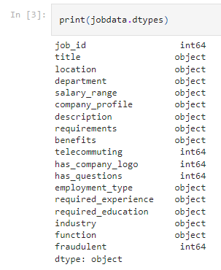
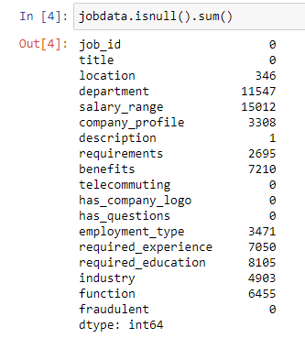
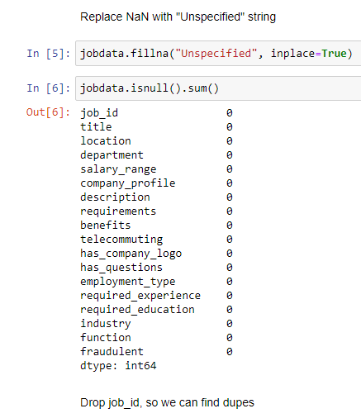
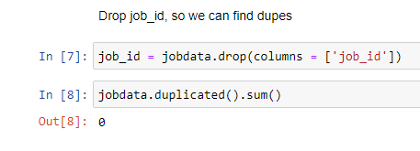
Simple Cleaning
Filling up Nulls

Slide 7
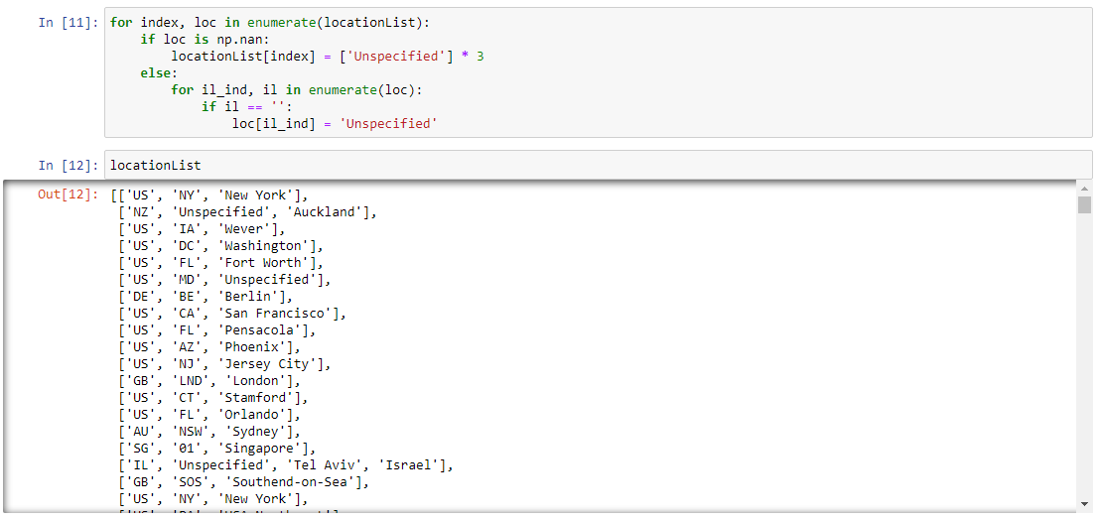
Data Cleaning (Location)
Filling up Nulls

Slide 8
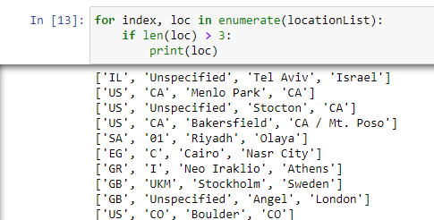
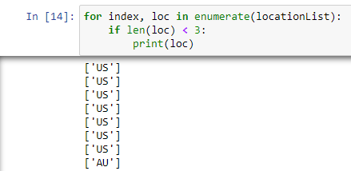
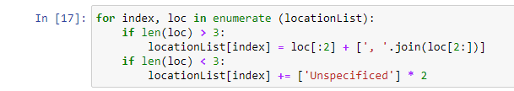
Data Cleaning (Location)
Locate Values with missing information

Slide 9
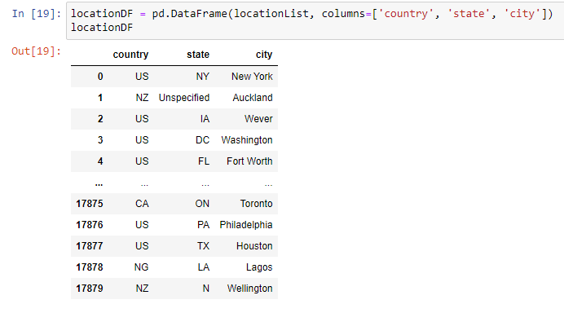
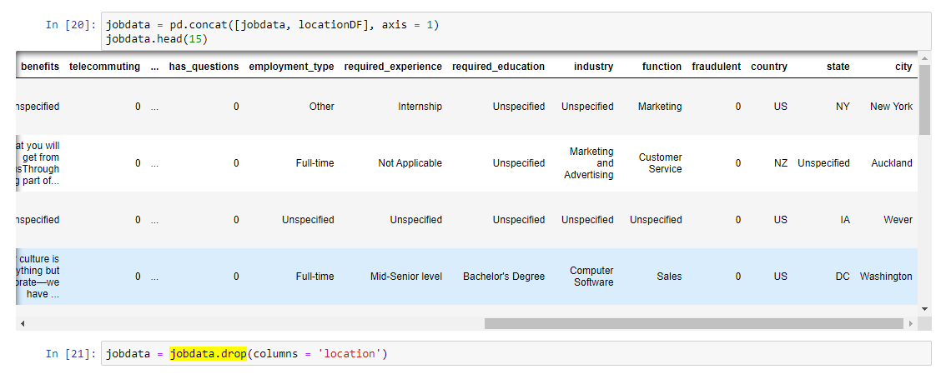
Data Cleaning (Location)
Location cleaned up!

Slide 10
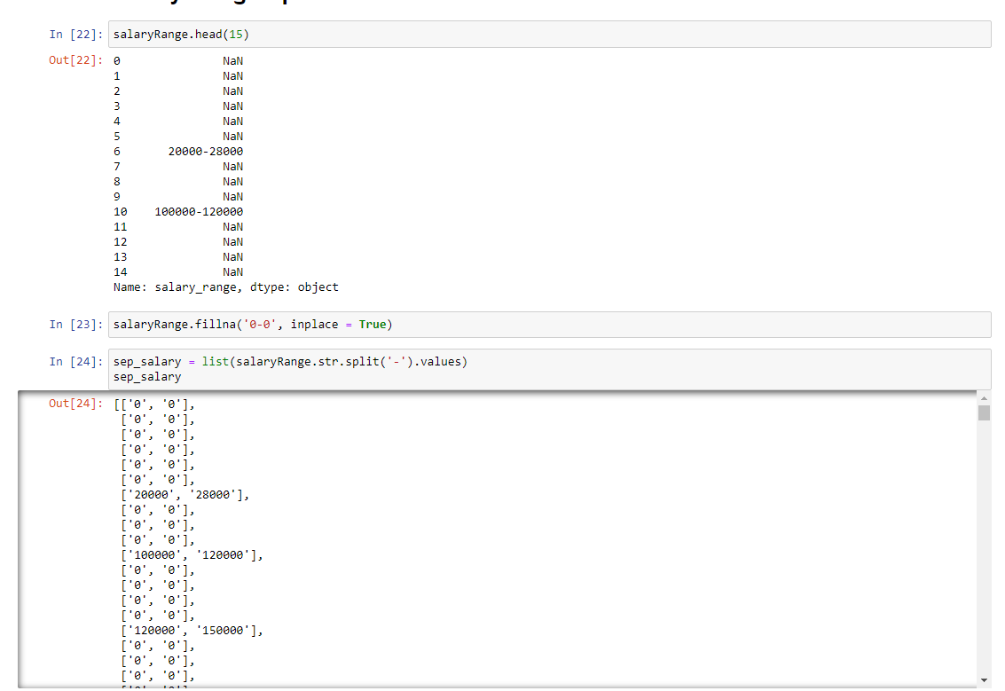
Data Cleaning (Salary)
Empty Salary change to “0” to “0”

Slide 11
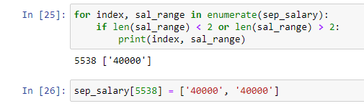
Data Cleaning (Salary)
Single value salary

Slide 12
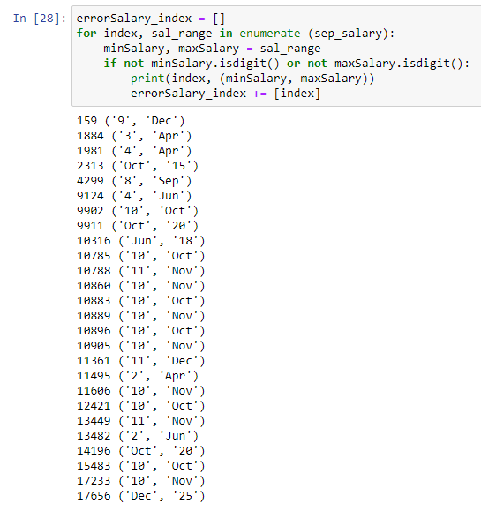
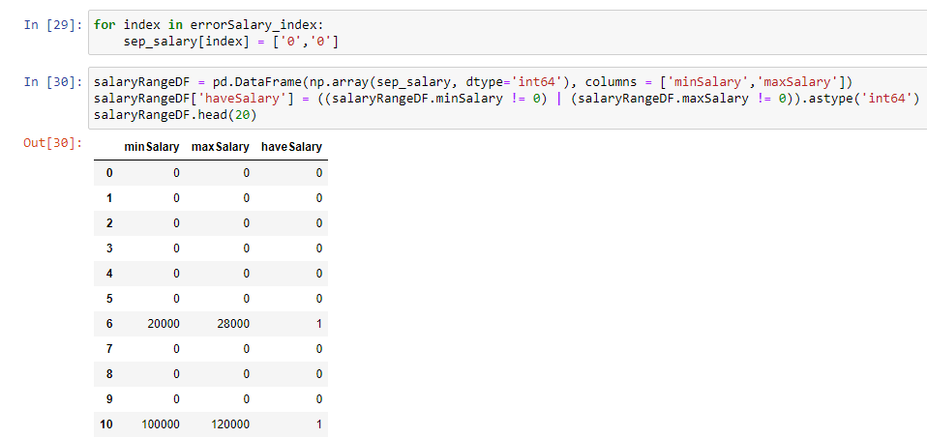
Data Cleaning (Salary)
Invalid Salary Entries

Slide 13
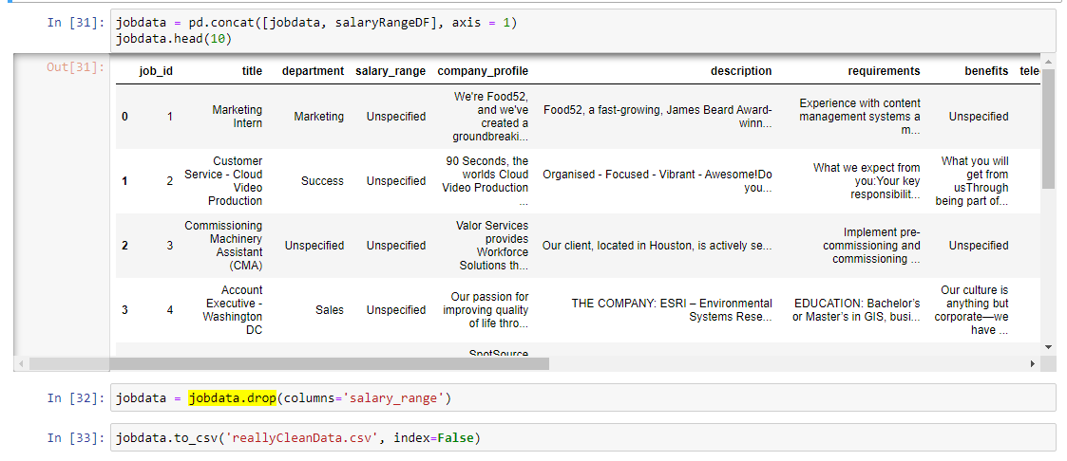
Data Cleaning (Salary)
Salary Cleaned up!

Slide 14
Exploratory Data Analysis (EDA)
01
Data Distribution
Distribution of Dataset
02
Numerical EDA
Salary
03
Categorical EDA
Telecommuting, company logo, questions, etc.

Slide 15
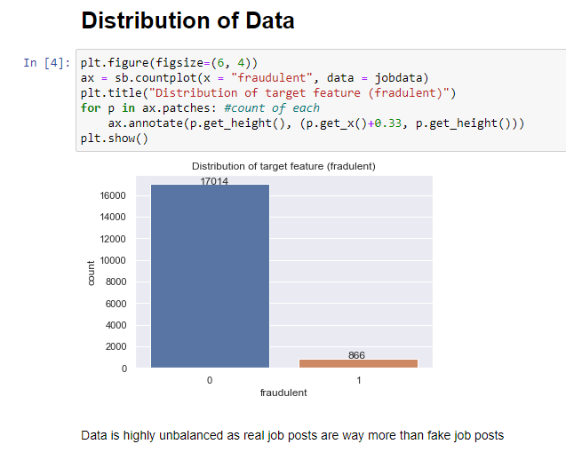
Data Distribution
Imbalanced Dataset

Slide 16
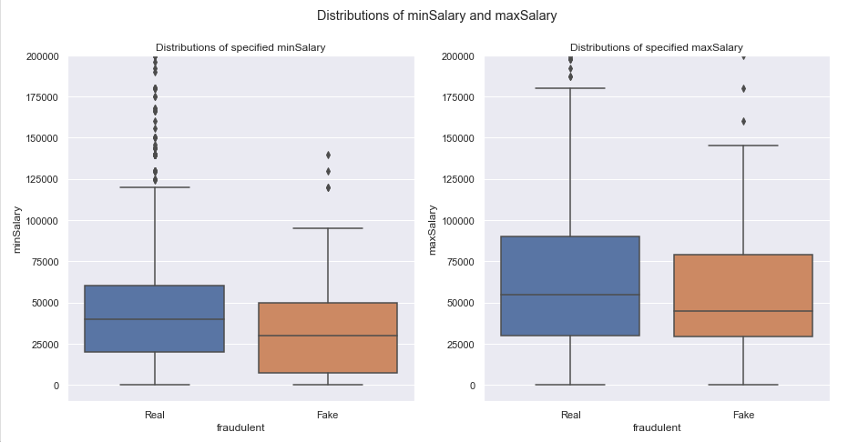
Numerical EDA (Salary)
MinSalary have some difference compared to MaxSalary

Slide 17
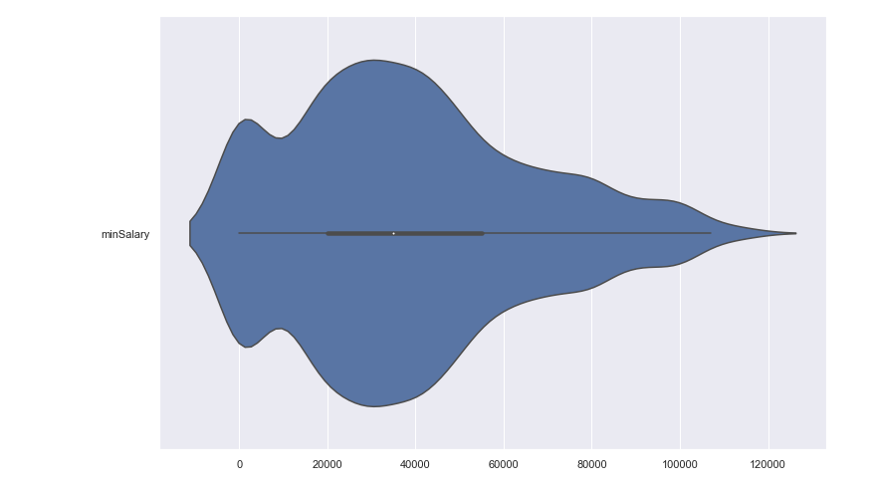
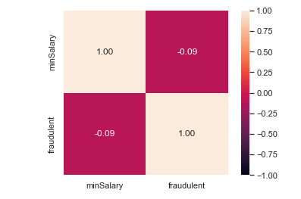
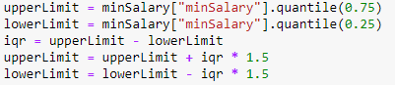
Numerical EDA (Salary)
Violin Plot for minSalary after removing outliers

Slide 18
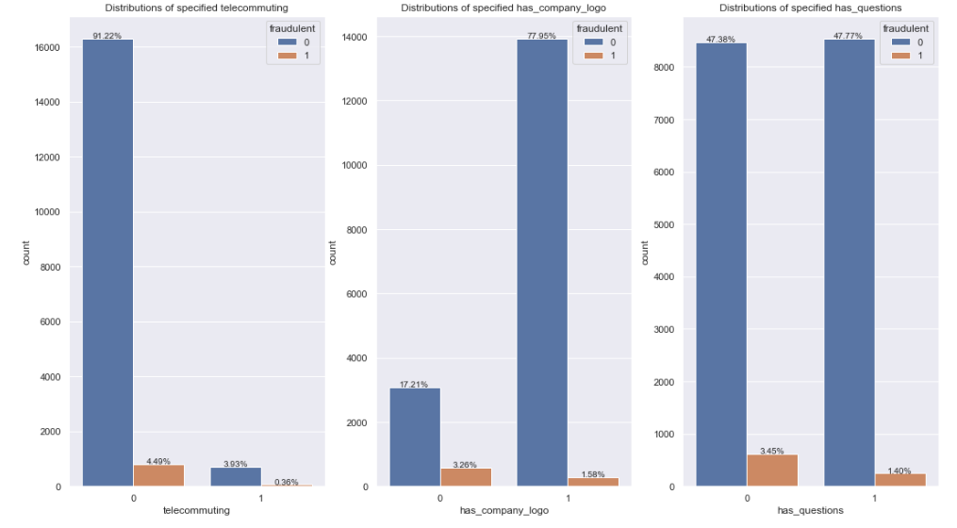
Categorical EDA

Slide 19
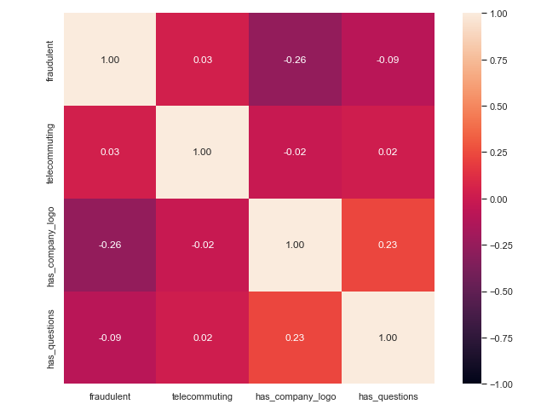

Categorical EDA

Slide 20
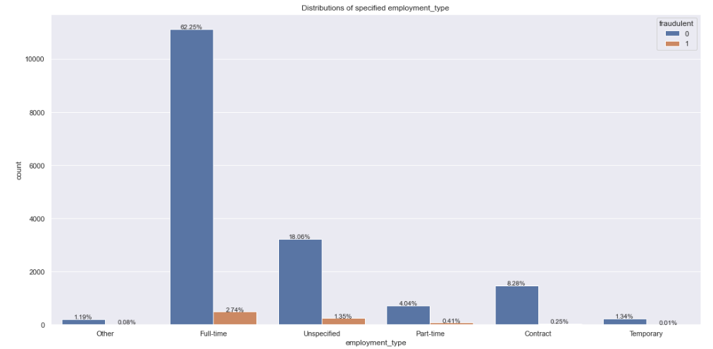
Categorical EDA (employment_type)

Slide 21
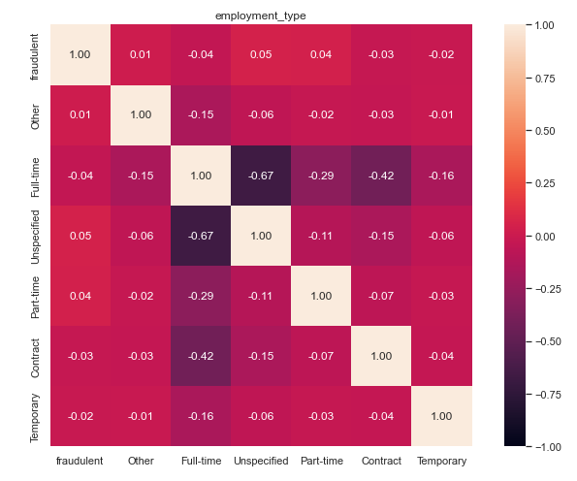
Categorical EDA (employment_type)

Slide 22
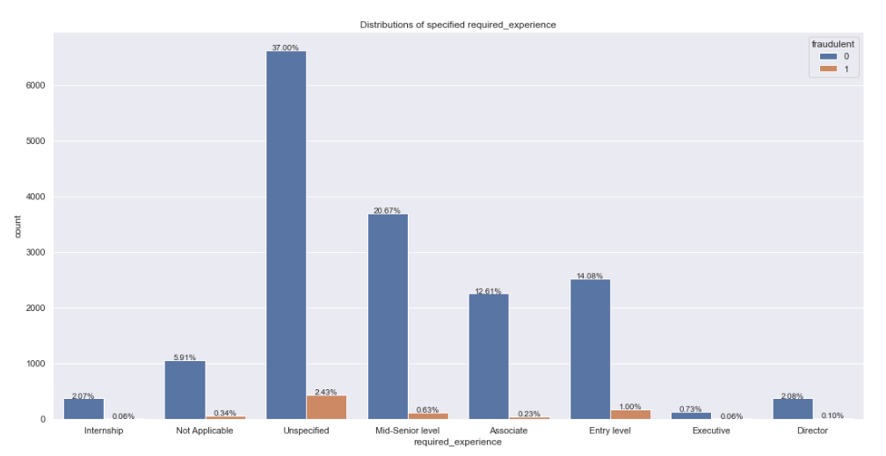
Categorical EDA (required_experience)

Slide 23
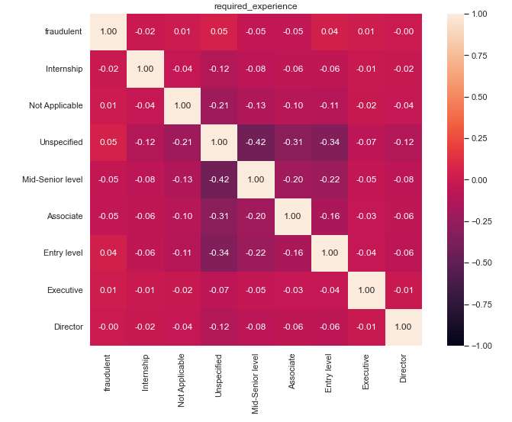
Categorical EDA (required_experience)

Slide 24
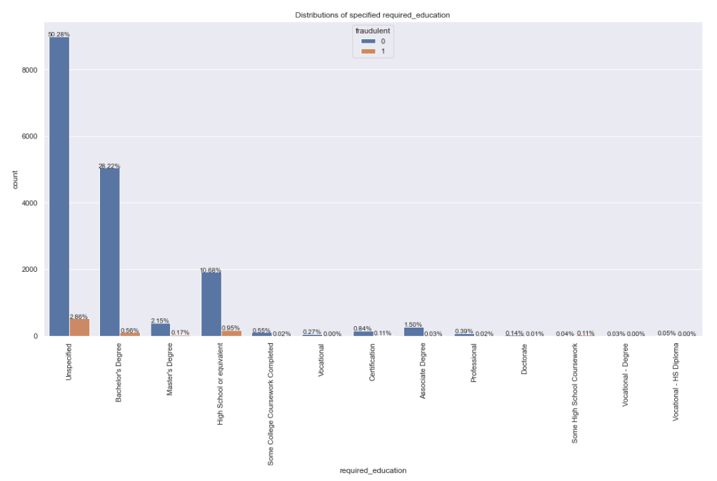
Categorical EDA (required_education)

Slide 25
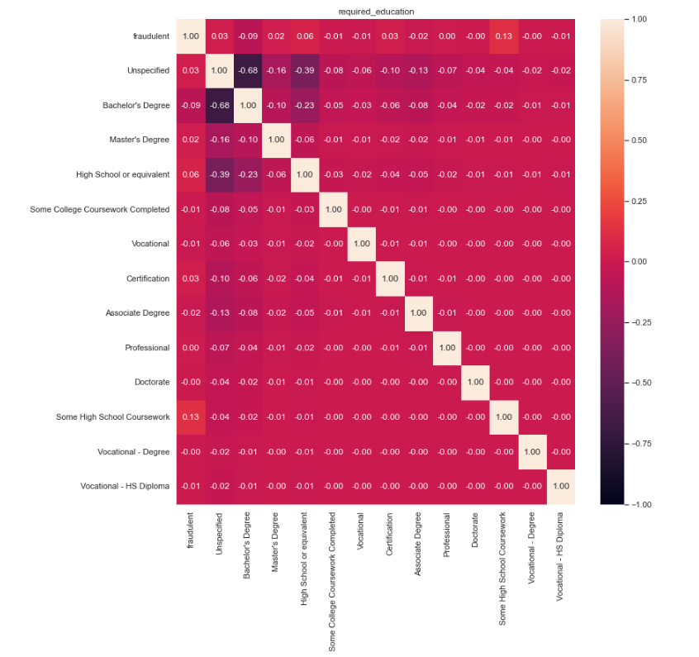
Categorical EDA (required_education)

Slide 26
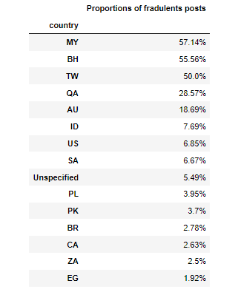
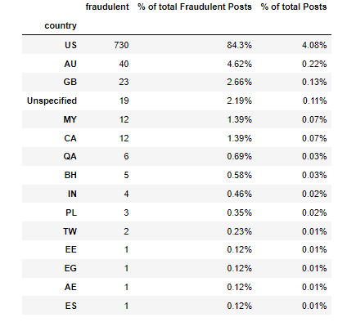
Categorical EDA (Country)
Top 15

Slide 27
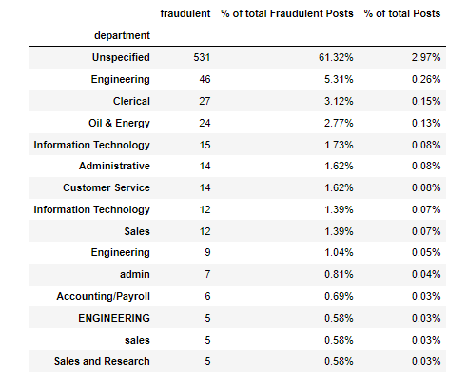
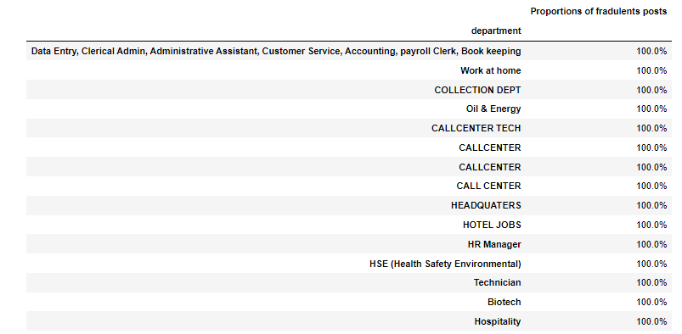
Categorical EDA (Department)
Top 15

Slide 28
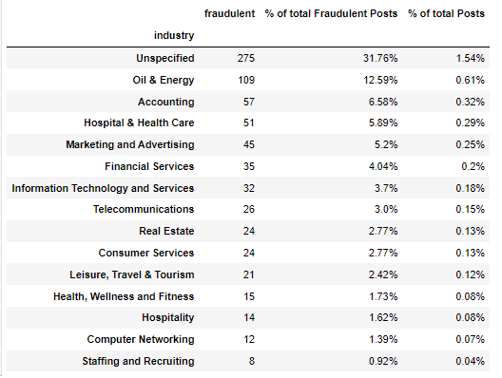
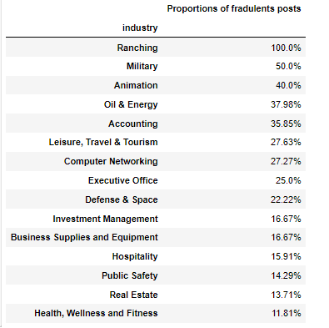
Categorical EDA (Industry)
Top 15

Slide 29
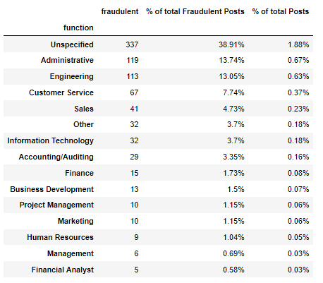
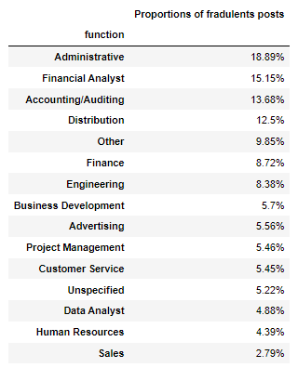
Categorical EDA (Function)
Top 15

Slide 30
Natural Language Processing
Cleaning
Spam filtering
NLP
Tokenization
Vectorization
Clustering

Slide 31
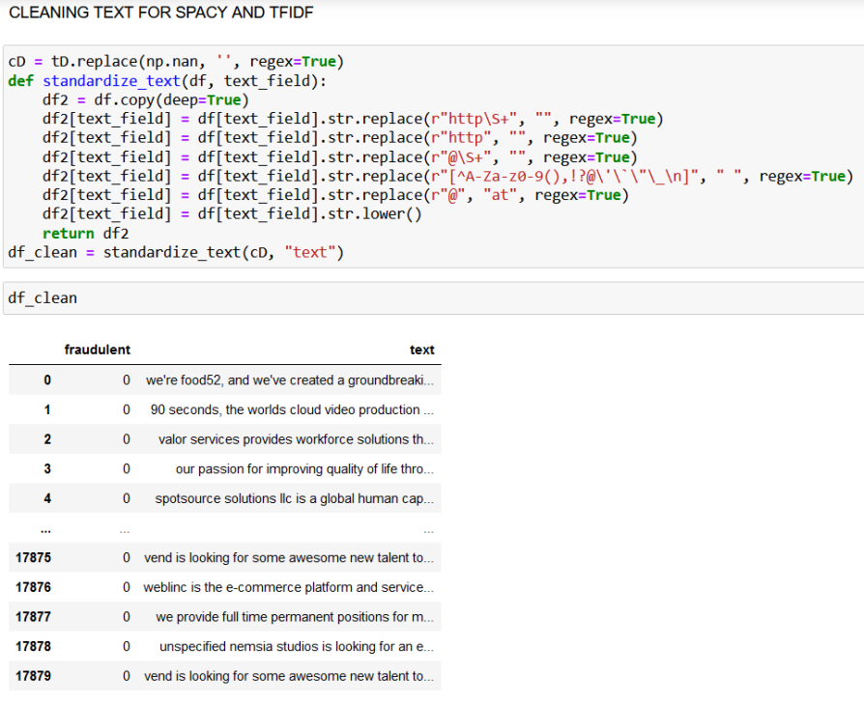
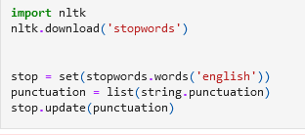
Natural Language Processing
Preliminary-Cleaning
Meaningful
Remove
Words
Characters

Slide 32
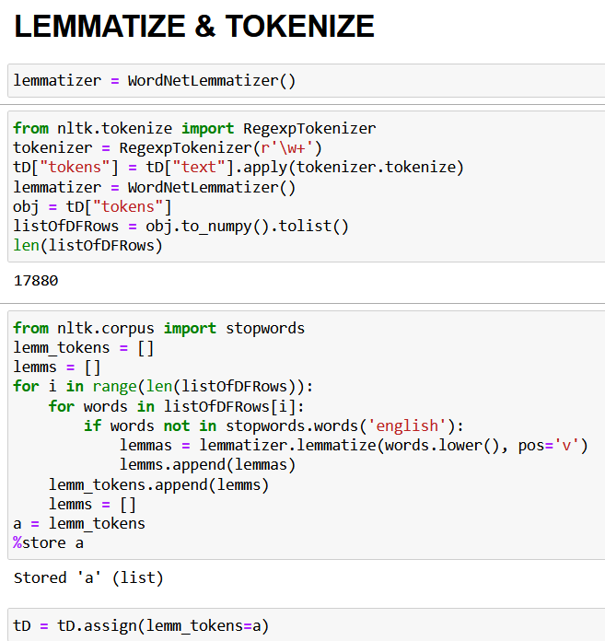
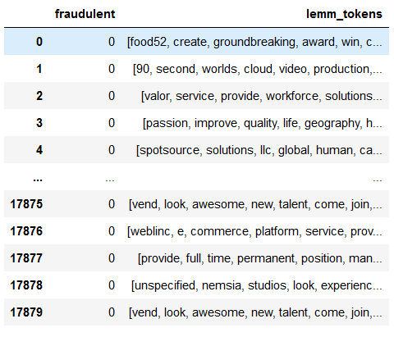
Natural Language Processing
Tokenization
Lemmatization
Turn each word into their common form
Based on context

Slide 33
Natural Language Processing
Lemm
Stemm
Playing
Played
Play
Play
Caring
Cared
Care
Car

Slide 34
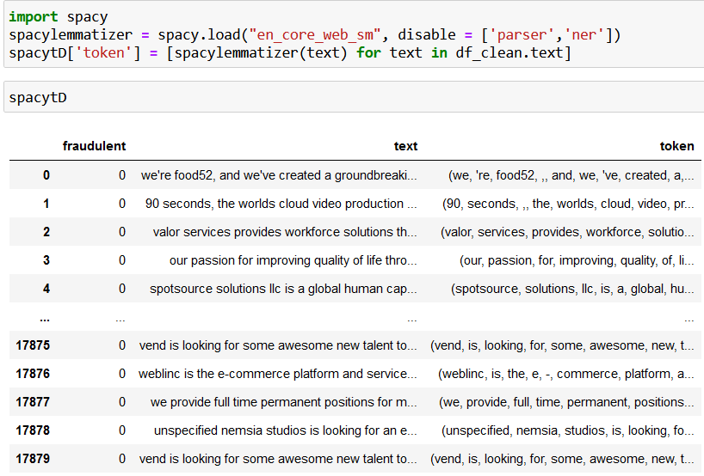
Natural Language Processing
Tokenization
Spacy vs NLTK
Performance difference

Slide 35


Natural Language Processing
Fraudulent
Non-Fraudulent

Slide 36
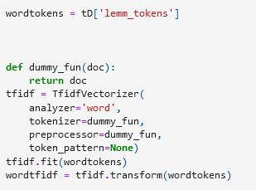
Natural Language Processing
Vectorization
Frequency
Mapping
Words -> Vectors
Notes:
TF-IDF is an abbreviation for Term Frequency Inverse Document Frequency. This is very common algorithm to transform text into a meaningful representation of numbers which is used to fit machine algorithm for prediction.

Slide 37
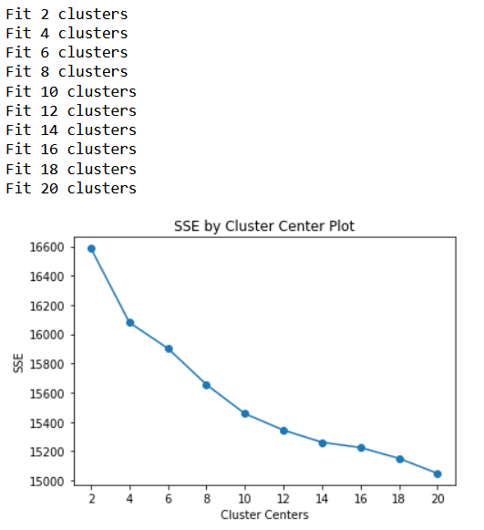
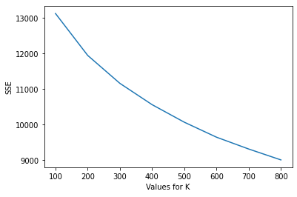
Natural Language Processing
Elbow point
Clustering
Find K Means
Elbow Point

Slide 38
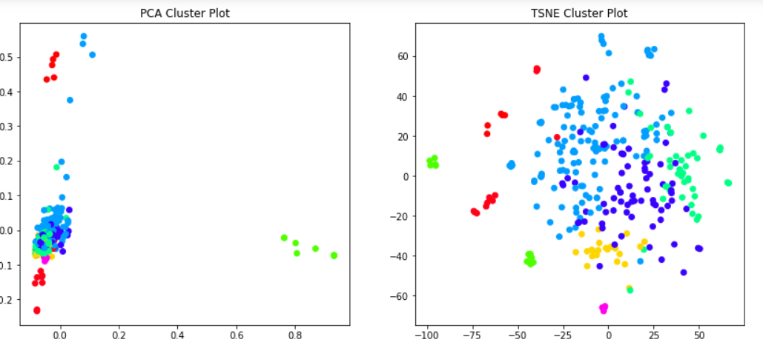
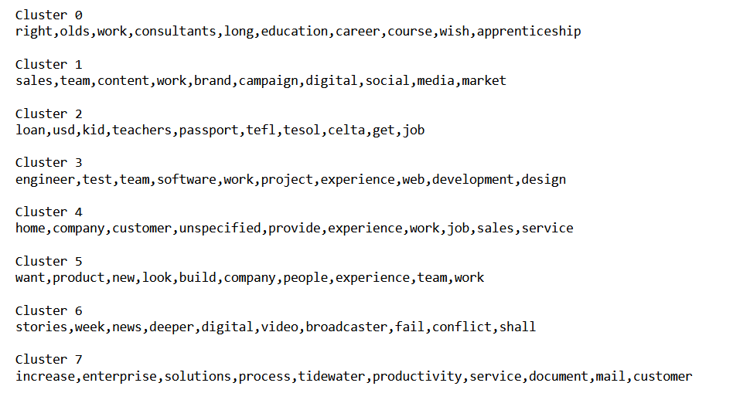
Natural Language Processing
Clustering
Keywords of each cluster
Cluster Representation
PCA
TSNE

Slide 39
Dataset preparation and testing
Data selection
Text columns company_profile, description, benefits, requirements
Columns were also concatenated into text variable
StratifiedKfold was used to split data into train and test sets
Each fold contains the same proportion of real and fake listings
Cross validation to get a better estimate model effectiveness
F1-Score will be the metric to evaluate the models
Main concern is false negative count, fake listings classified as real
Notes:
As we could not find any correlation in the categorical data to identify fraudulent listings, we decided to apply NLP to the text data and check if ML Classifiers could identify fraudulent listings from there.
We selected all the text columns in our data set, and also concatenate the columns into a single text variable
StratifiedKfold is used to split our imbalanced data evenly into train and test sets, and this cross validation should give us a better estimate on the classifiers effectiveness.
F1-score will be the metric to evaluate the classifiers, as our main focus is on the false negative results which are more harmful to job seekers.

Slide 40
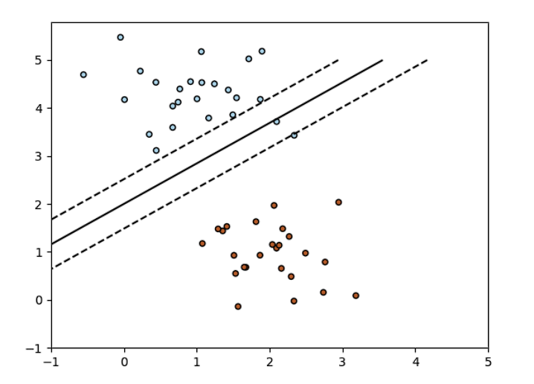
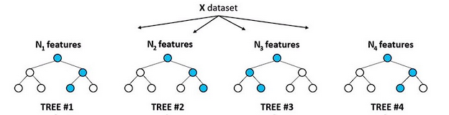
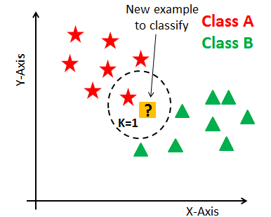
Machine Learning Classifier Models
SGD Classifier
Random Forest
K-Neighbours
Notes:
To find the best machine learning classifier for detecting fake job listings, we tested out various classifiers and narrowed our search to these 3, SGD classifier, random forest and k-neighbours classifiers.

Slide 41
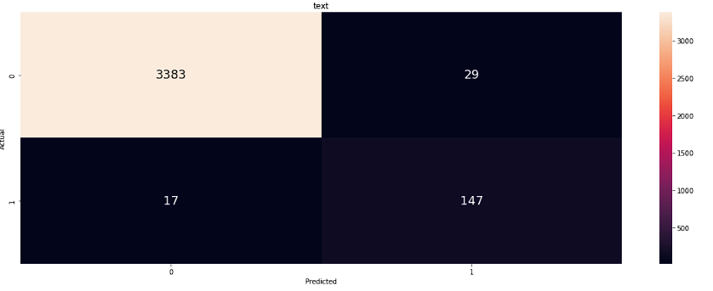
SGDClassifier
Stochastic gradient descent learning routine
Mean F1-score: 0.82
Test F1-score: 0.86
Time taken: 13.1 seconds
Parameters
class_weight = “balanced”
loss = “modified_huber”
 | Train Set | Test Set
Mean F1 Score | 0.82
F1 Score |  | 0.86
Cross Validated Result
Confusion Matrix
Notes:
The results shown here are from the text variable, which is the concatenation of all text columns. We observed that the f1-scores from this variable is consistently the highest across all 3 ML classifiers.
The mean f1-score is represents the result of our kfold validation on our training set, while the final f1-score is the result of our testing set.
For SGDClassifier, we applied the class_weight “balanced” parameter to give more weight to the fraudulent data to counterbalance, and loss to modified_huber, to allow more tolerance for outliers in the data, and got f1-score of 0.86 and time taken was 13.1 seconds

Slide 42

Random Forest
A large number of relatively uncorrelated decision trees make a choice
Mean F1-score: 0.64
Test F1-score: 0.65
Time taken: 767.0 seconds
Parameters
n_neighbours = 200
class_weight = “balanced”
 | Train Set | Test Set
Mean F1 Score | 0.64
F1 Score |  | 0.65
Cross Validated Result
Confusion Matrix
Notes:
For random forest, the model creates many individual decision trees to make class prediction and the class with the most votes becomes the model’s prediction.
Likewise, we applied a class_weight of “balanced” to give fraudulent data more weight, and attained a f1-score of 0.72 and time taken was 767 seconds

Slide 43

K-Neighbours
Assumes similar data points are close to each other and can be grouped together
Mean F1-score: 0.81
Test F1-score: 0.85
Time taken: 49.3 seconds
Parameters
weights=”distance”
 | Train Set | Test Set
Mean F1 Score | 0.81
F1 Score |  | 0.85
Cross Validated Result
Confusion Matrix
Notes:
And finally, K-neighbours assumes that similar data points are closed together, and can be identified together. So real job listings are similar to other real jobs listings and fake jobs listings are similar to fake job listings.
The weight=”distance” parameter is applied to give fraud data more weight, and we attained a f1-score of 0.85 and time taken was 49 seconds

Slide 44
Insights and Recommendations
Numerical and Categorical Variables
01
Lack of Correlation
Combined Text
02
Combined Text Data provided best accuracy
Best Model - SGDClassifier
03
Fastest and Best Results
Unspecified Information
04
Empty “Industry”,”Department”, “Function” is clear indication of fraudulent post

